Slide 1
Lost in Translation
Three reflections on how research insights are lost in translation
December 9, 2022, HFI UX Conference
Courtney Sneed, Director of UX Research, Elsevier

Slide 2
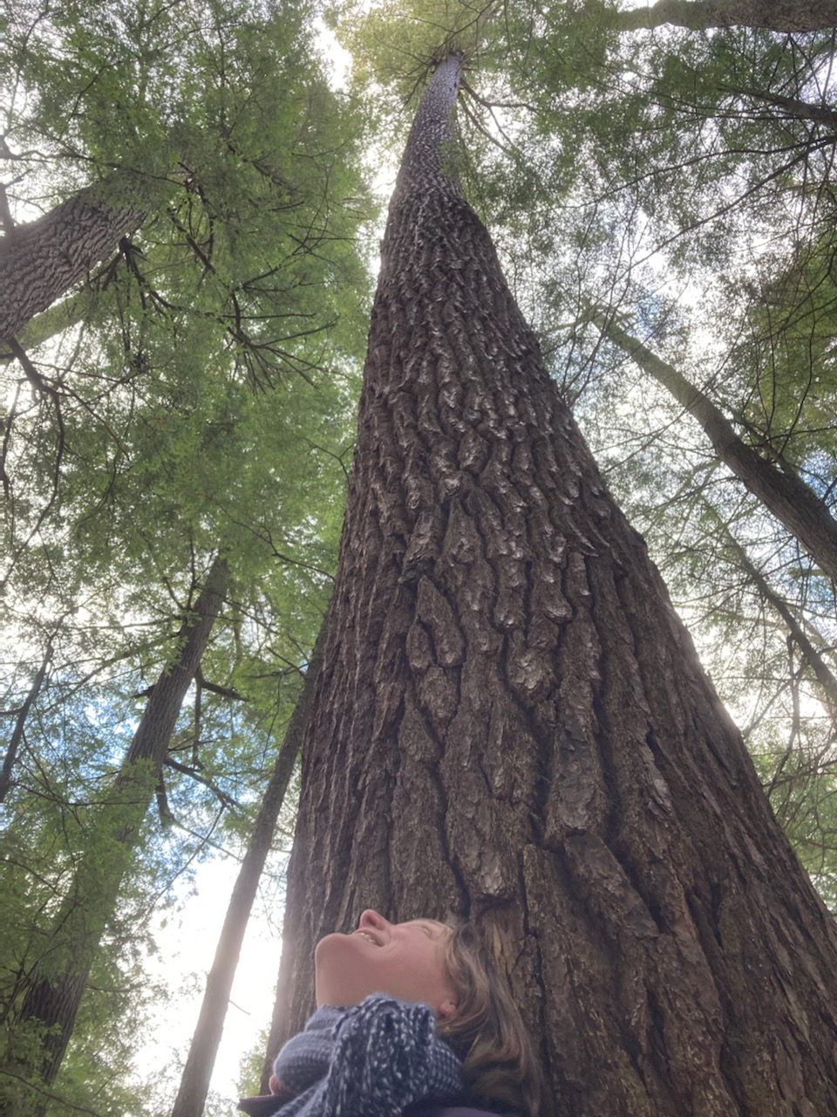
Introduction
What this is:
My reflections from working with global teams for over 19 years.
What this is not:
A formal paper from exhaustive evidence, and extensive experimentation.
A view from someone who has “arrived”. Many of these insights are still work in progress.
Notes:
Elsevier Vision Statement
“Elsevier is a global leader in information and analytics that helps researchers and healthcare professionals advance science and improve health outcomes for the benefit of society.”
https://nonsolus.elsevier.net/Content/Page/Index/0193022a-95ac-49c9-bab6-89843074c8d5?
Elsevier Mission Statement
“Elsevier helps researchers and healthcare professionals advance science and improve health outcomes for the benefit of society.
We do this by facilitating insights and critical decision-making for customers across the global research and health ecosystems.
Learn more
https://www.elsevier.com/about/this-is-Elsevier

Slide 3
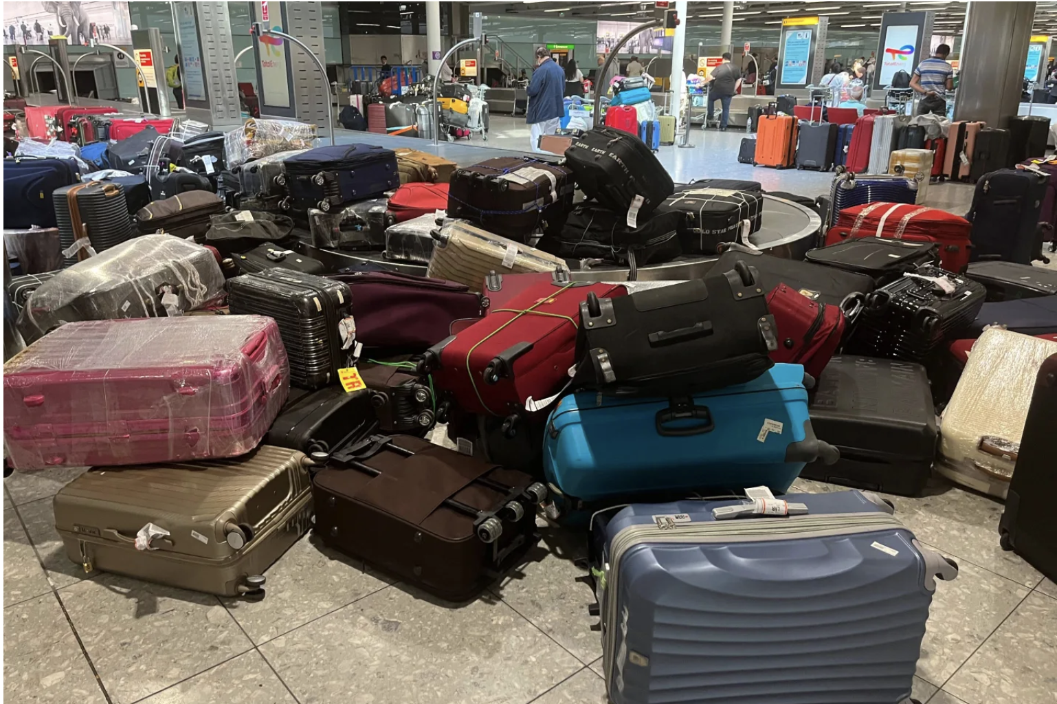
Ich bin
গর্ভবতী
Notes:
Garbhabatī

Slide 4
3 Ways Translation Breaks Down
1. Who. The people who research are not embedded in the culture.
2. Why. The deep needs that underlie behaviors are not extracted and mapped to jobs-to-be-done.
3. How. Insights without traceability leave room for misinterpretation, or worse, no action at all.
Notes:
Elsevier Vision Statement
“Elsevier is a global leader in information and analytics that helps researchers and healthcare professionals advance science and improve health outcomes for the benefit of society.”
https://nonsolus.elsevier.net/Content/Page/Index/0193022a-95ac-49c9-bab6-89843074c8d5?
Elsevier Mission Statement
“Elsevier helps researchers and healthcare professionals advance science and improve health outcomes for the benefit of society.
We do this by facilitating insights and critical decision-making for customers across the global research and health ecosystems.
Learn more
https://www.elsevier.com/about/this-is-Elsevier

Slide 5
1. WHO

Slide 6
Assumptions made out of context miss insights, and curtail scalable product development.

Slide 7
Tasked with verifying if this assumption is true, a Chinese user researcher joins the team.
Case Study #1
She rapidly interviews doctors, familiar with time constraints of 3-4 mins per patient.
A western product team assumes the same solution for diagnosing patients in the US will work in China.
She understands Tier 1, Tier 2 and Tier 3 hospitals. She knows how decisions are made.
She understands the opportunities available, and advocates for a different direction shared in the US & China contexts.

Slide 8
A team of Indian researchers are hired to interrogate this, from an Indian point of view:
Indian user researchers know the public health sector.
Case Study #2
A western product team assumes Indian rural frontline health workers have simple systems for screening patients.
They respect the constraints of hierarchy, knowing a nurse would never share painpoints before her superior. They know how to moderate, dramatizing scenarios, engaging participants, echoing Bollywood drama.
They contribute to an extensive mental model detailing multiple complex systems at work.

Slide 9
Out of context assumptions miss insights, and curtail scalable product development.
Relying on user researchers closest to the context to reveal insights can scale product development.

Slide 10
2. WHY

Slide 11
In the rush to implement, mental models are shelved for agile approaches, resulting in Winchester houses.

Slide 12
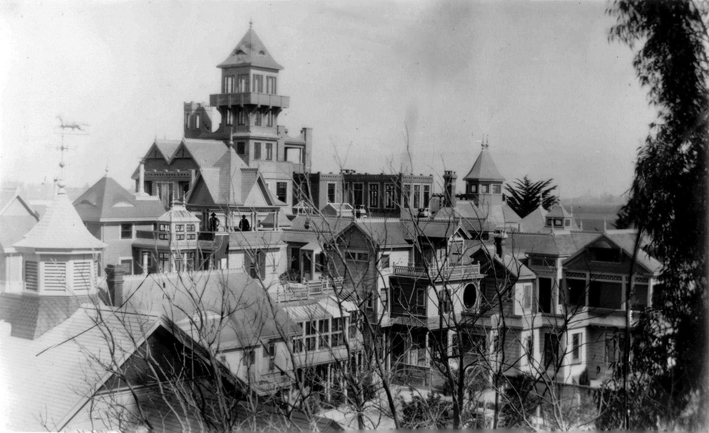

Slide 13
Mental Models Create Task Cohesion
Anchoring needs to behavior, mental models cohesively tie JTBD, micro-task clusters together in a meaningful way.
Notes:
Not enough to know how valued the tasks are, but also how they connect.
Indi Young’s initial work on this, gives us an tried organizing framework – that utilized with Ulwick’s Outcome Driven Innovation, is a powerful combo.

Slide 14
In the rush to implement, mental models are shelved for agile approaches, resulting in Winchester houses.
Mental models anchor needs to behavior, cohesively mapping interlocking tasks necessary for success.

Slide 15
3. HOW

Slide 16
Findings embedded in tools break Fitts law for usability: they are too removed from the actual work.

Slide 17
Findings Separated from Work = Dissonance
User Research Findings
Work Getting
Done
Dovetail
Jira
No traceability:
1. Cannot see which story is related to which finding.
Confluence
2. Cannot measure the velocity of findings implemented in Jira pipelines.
Airtable

Slide 18
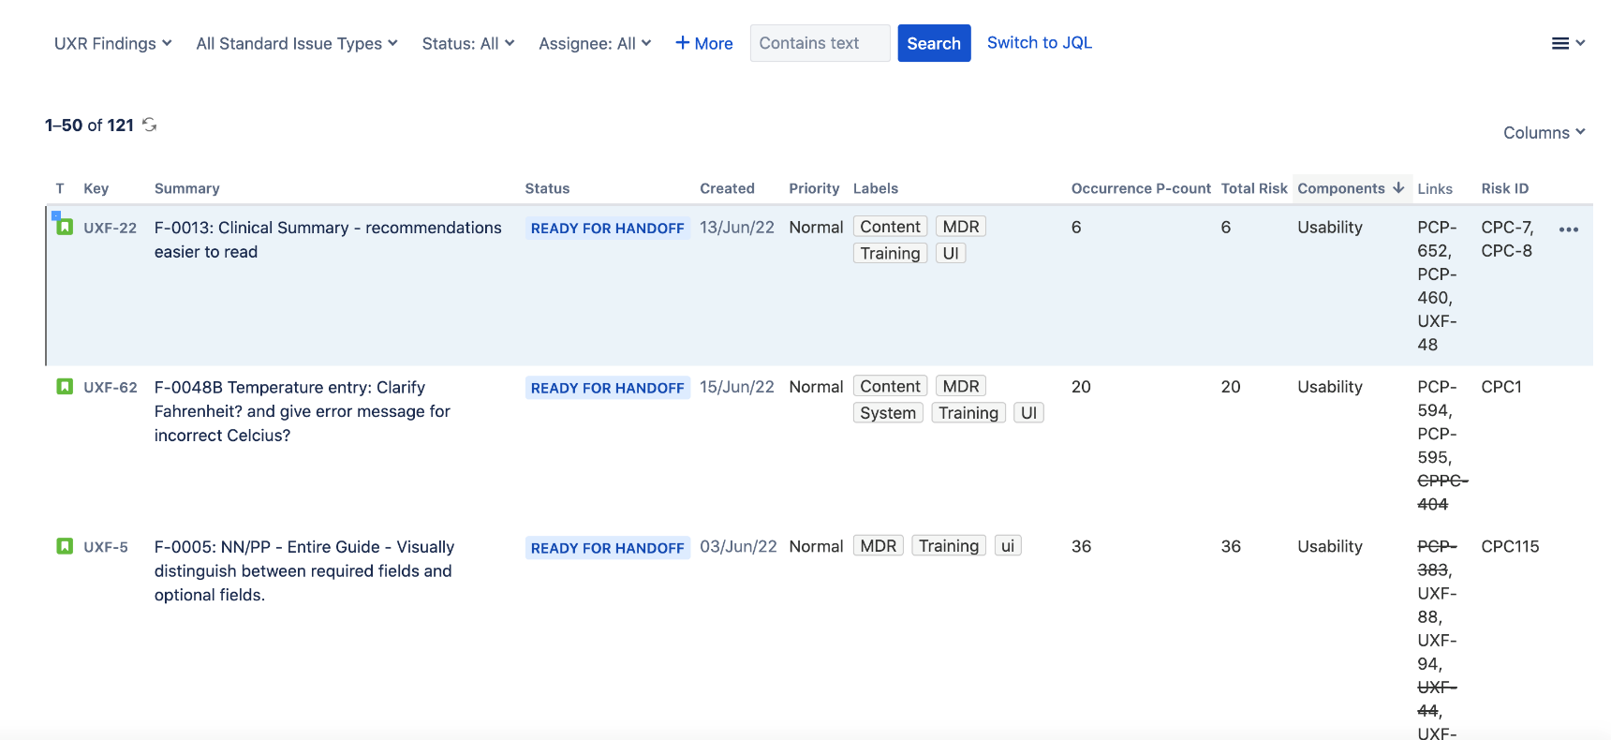
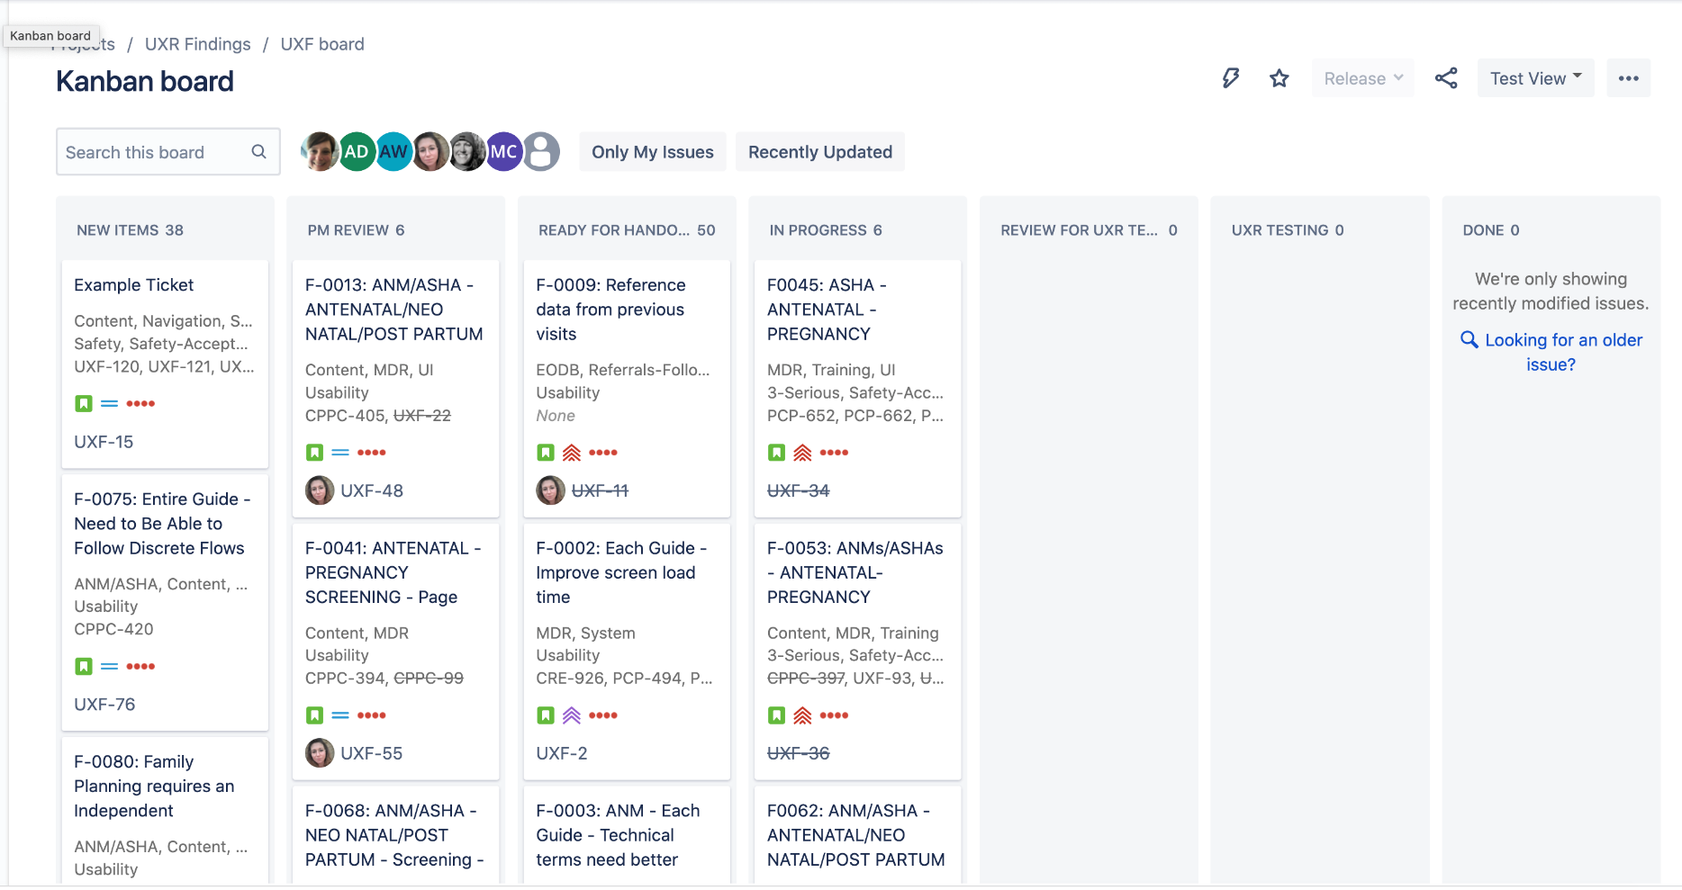
Findings Embedded Expose Improvements
Findings directly in Jira, enabled us to:
Link findings to actual tickets in multiple squads’ Jira boards.
Verify tickets related to the findings truly solved the findings.
See ambiguous findings that needed revision.
Notes:
Under current: This exposed two areas of weakness – the engineering tickets were not fully related. The UXR findings were not coherent.

Slide 19
Findings embedded in tools break Fitts law for usability: they are too removed from the actual work.
Entered in Jira: accountability increases for UX, product and engineers, resulting in greater production integrity.

Slide 20
Wrap Up
1. Local researchers enable contextual insights and bi-directional influence for true global scale.
2. Mental Models anchor behavior to needs, within a cohesive task framework. This powerfully combats “Winchester House” product development.
3. Findings deserve traceability in proximity to work. Traceability increases 360 accountability to delivering better solutions.

Slide 21
Questions?

